Slide 1
Artist Access
Daniel Osborne
Vishva Kulatunga
Anjula Epasinghe

Slide 2
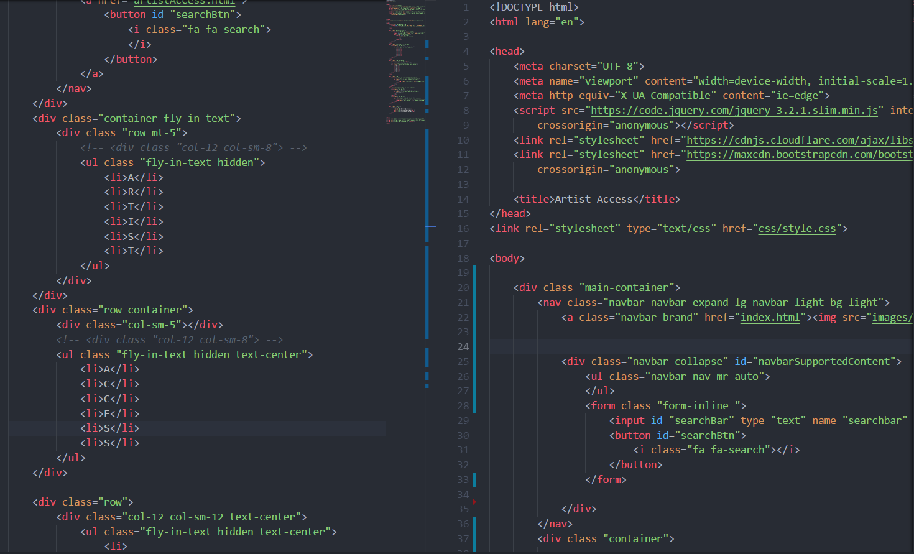
HTML

Slide 3
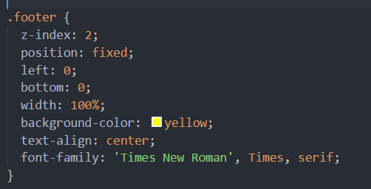
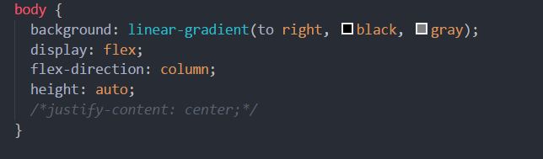
CSS

Slide 4
Bootstrap
Bootstrap was used for styling as well
<div class="row">…</div>
<div class="col-12 col-sm-12 text-center">
<div class=“text-white”>

Slide 5
Shizzle.js
Animation for the title
<script src="https://ajax.googleapis.com/ajax/libs/jquery/2.1.3/jquery.min.js"></script>

Slide 6
Video Background
<div class="background-wrap">
<video id="video-bg-elem" preload="auto" autoplay="autoplay" loop="loop">
<source src="stars.mp4" type="video/mp4"
</video>
</div>

Slide 7
APIs
newsapi.org/mtv
Spotify
TicketMaster.com
openweathermap.org

Slide 8
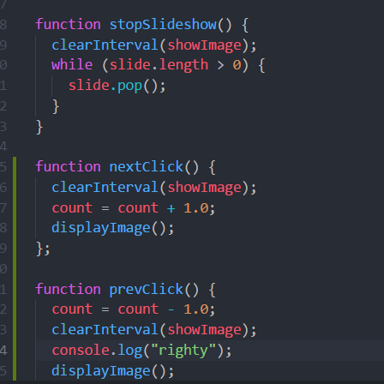
Slideshow js code
Code inherited from the class activity
Next and previous button added to switch slides at users will

Slide 9
Most challenging parts
Spotify API
Z index
Bootstrap links.

